Slide 1


Slide 2
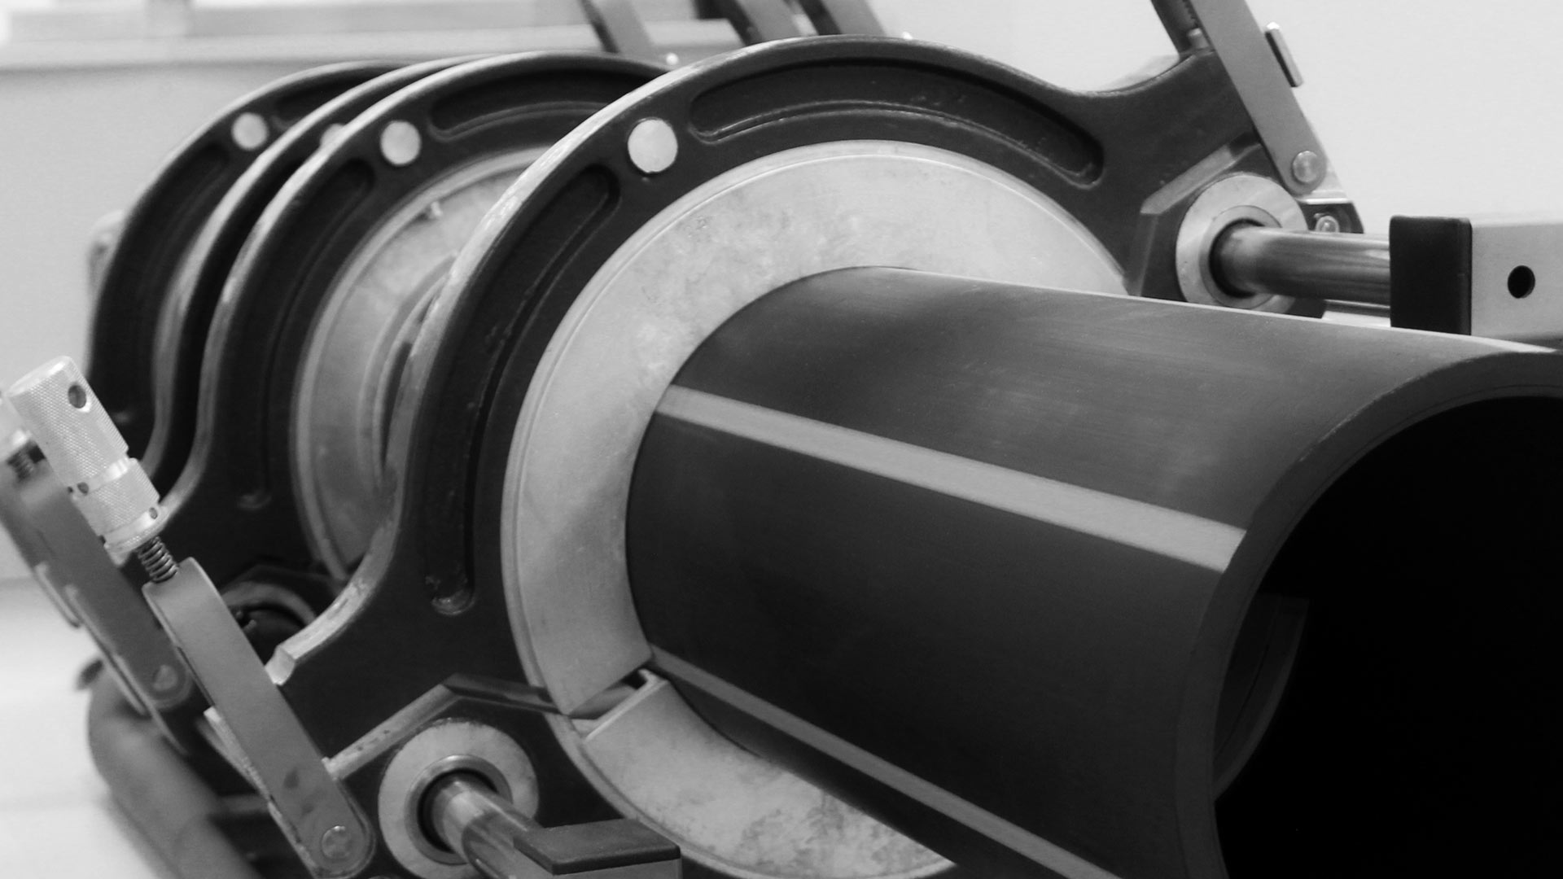



Innovative technique for welding plastic pipes.
Resilience
Sustainability
Quality

Slide 3
Tradition
We have been manufacturing in our own factory in Prague since 1992.
The first model of the welding machine was developed by the owner of the company Mr. Pavel Dvořák in 1986. It was the very first polyfusion welder with a mandrel heating element, which thanks to its practicality conquered the whole world and whose copies are now produced by countless companies around the world.
For more than 20 years we have been cooperating with major Czech and foreign companies such as Wawin, FV plast, Rothenberger, Thermaflex and others.

Slide 4
We do everything from A to Z
We manufacture more than 90% of our components on our own machines.
We have more than 30 years of experience in manufacturing and development.
Innovations and new products are designed by our developers and engineers.
We own 27 registered patents and countless utility models.

Slide 5

Our products

Slide 6
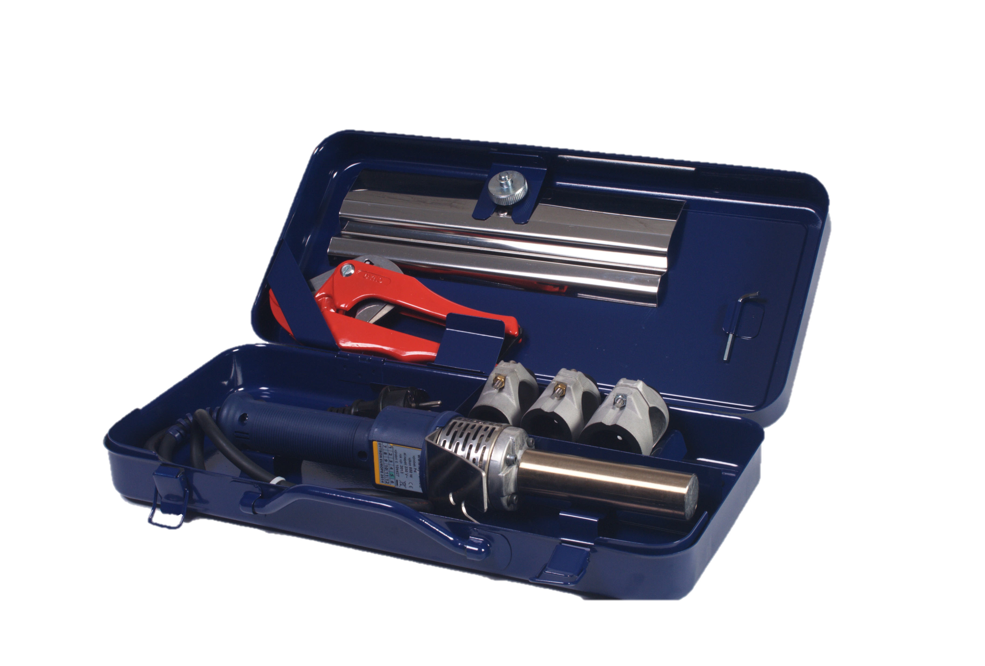
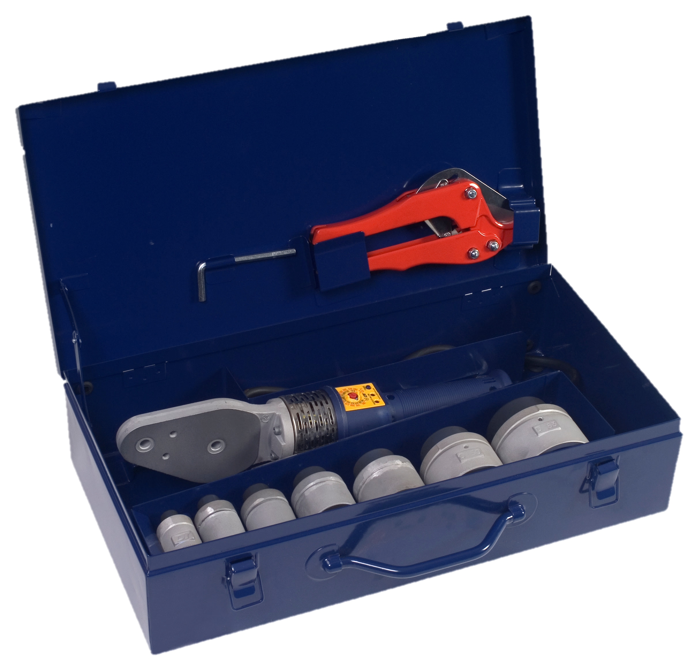

Manual welding equipment and accessories
Polys P4-a 650W MINI
Polys P4-a 850W PROFI

Slide 7
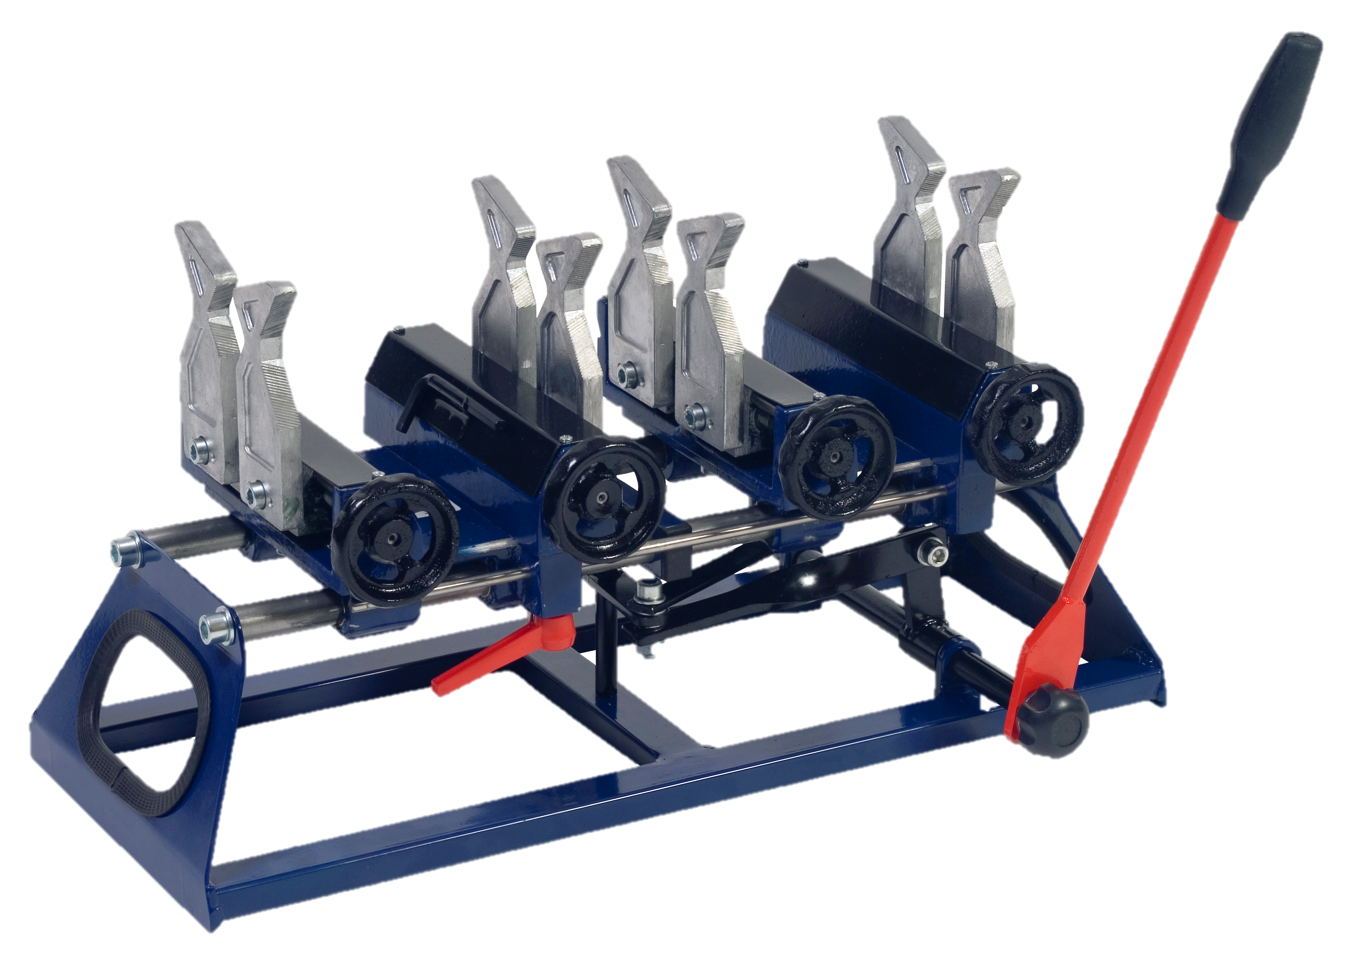
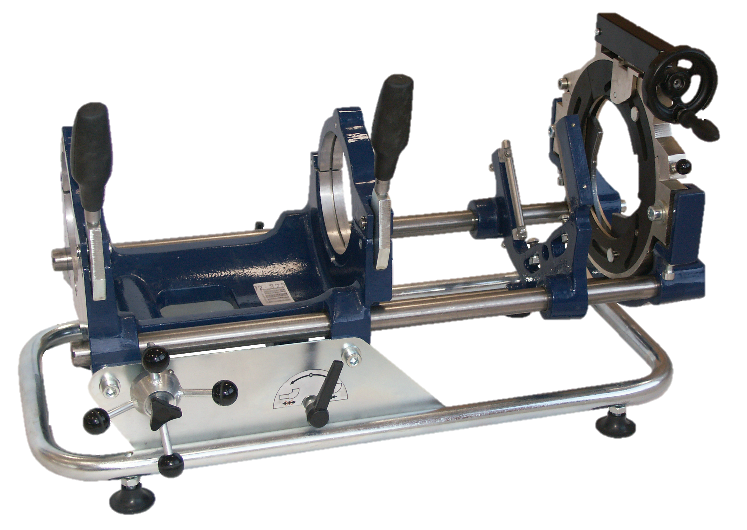
Mobile Equipment for fixation of pipes during fusion welding
MP - 110
MP - 75

Slide 8
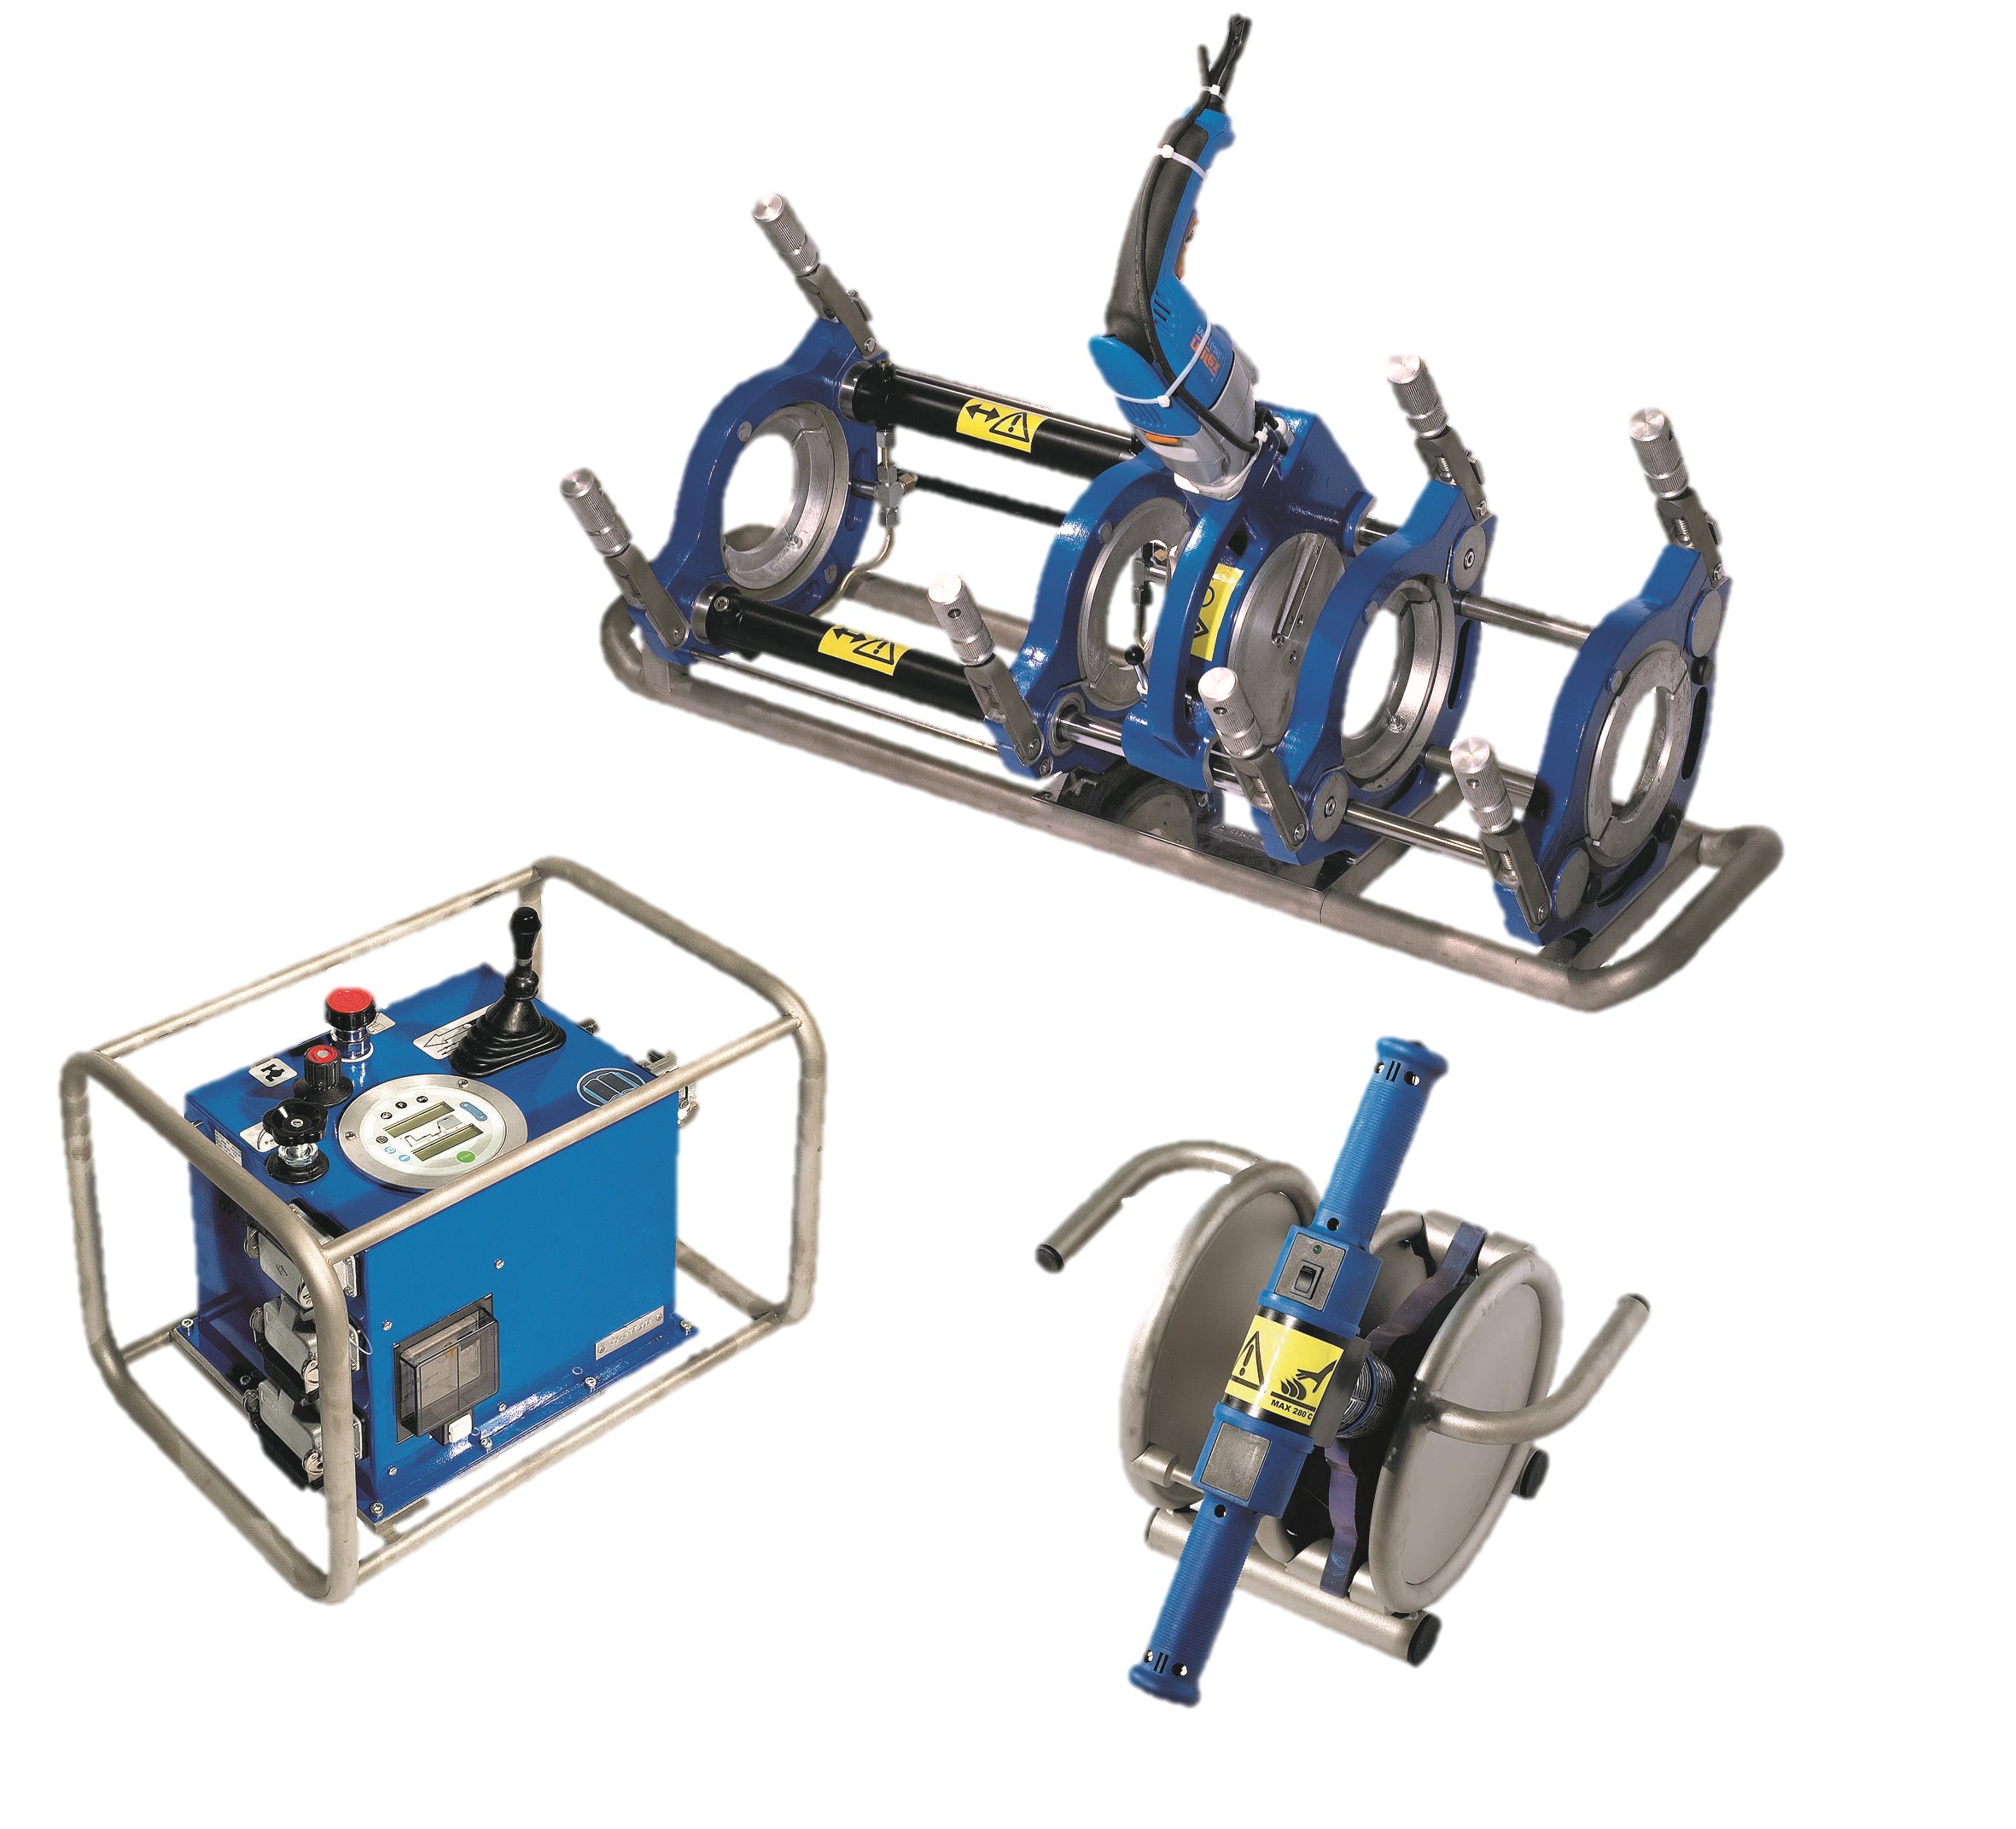
Hydraulic equipment
Designed for pipe welding for dimensions 40 - 2000mm
STH 160 - 900

